Slide 1
NEO4J CYPHER TUTORIAL WITH PYTHON
Set Properties To Neo4j Node Using Apoc Procedure & Python
Tutorial 100

Slide 2
Use case
Set Properties To Neo4j Node Using Apoc Procedure & Python

Slide 3
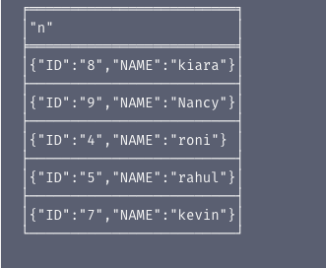
Set Properties To Neo4j Node Using Apoc Procedure & Python

Slide 4
Set Properties To Neo4j Node Using Apoc Procedure & Python
match(a)
with collect(a) as nodes
call apoc.create.setProperties(nodes,["Section","City"],["High","London"])
yield node
return node
Code written in neo4j browser

Slide 5
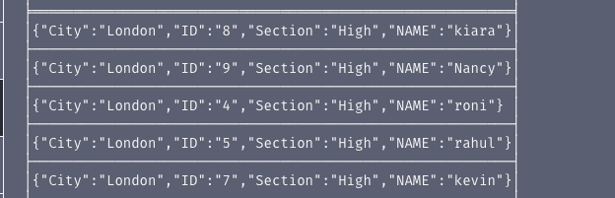
output
From neo4j browser

Slide 6
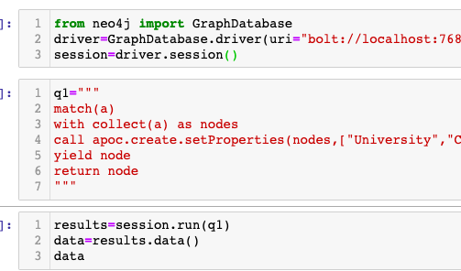
Set Properties To Neo4j Node Using Apoc Procedure & Python
Code written in python ide

Slide 7
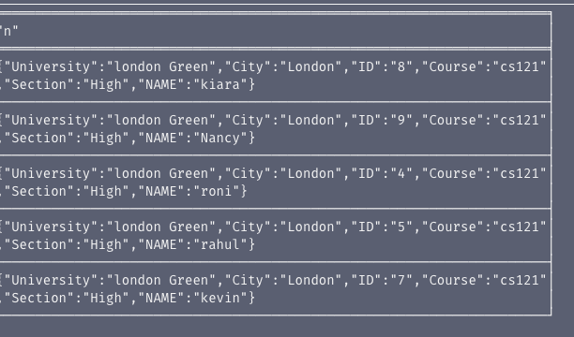
output
From python ide

